Slide 1
2.1 | Java Exceptions

Slide 2
Video Notes
Exception Basics
https://mediaplayer.pearsoncmg.com/assets/secs-vn-JI02-Exceptions
Using Exceptions
https://mediaplayer.pearsoncmg.com/assets/secs-vn-JI03-More-Exceptions

Slide 3
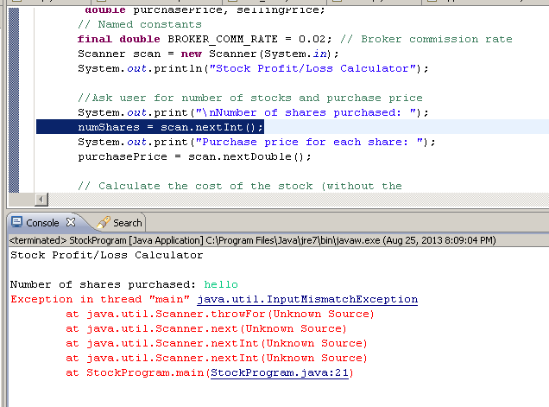
Unhandled Exception
Notes:
Your code will crash if it encounters an unhandled exception

Slide 4
Exception Handling
If an exception is ignored by the program, the program will terminate abnormally and produce a message
The message includes a call stack trace that:
indicates the line on which the exception occurred
shows the method call trail that lead to the attempted execution of the offending line
Example on previous slide
References
https://docs.oracle.com/javase/tutorial/essential/exceptions/index.html
https://www.codejava.net/java-core/exception
Notes:
https://explainjava.com/java-exceptions/

Slide 5
Java Exception
In Java, an exception (is an object that) describes an unusual or erroneous situation
Java has a predefined set of exceptions and errors that can occur during execution
In addition, Java supports user defined (custom) exceptions

Slide 6
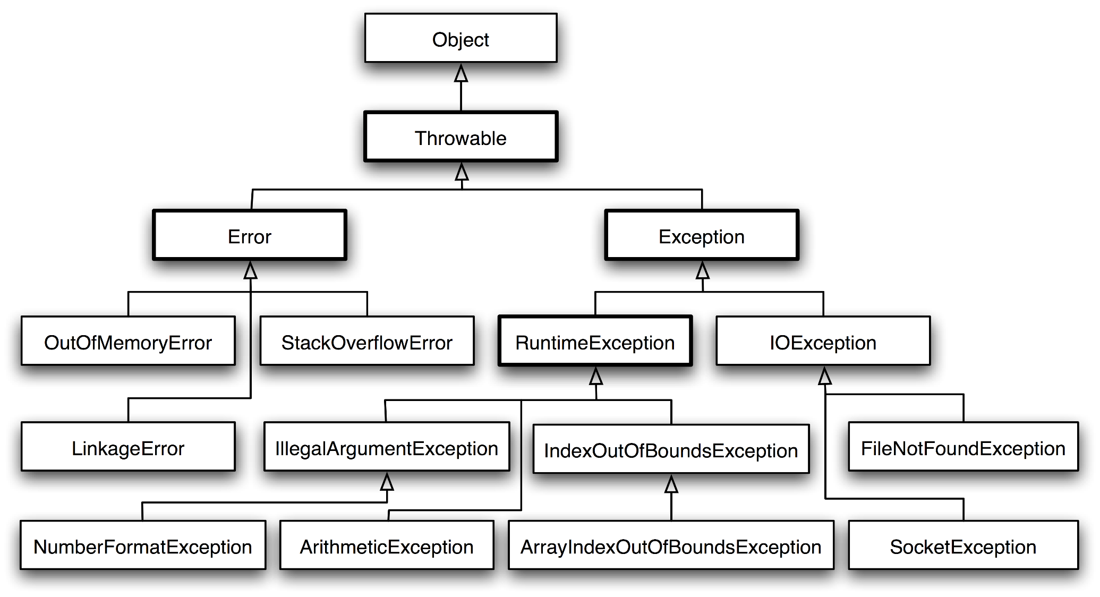
Exception Class Hierarchy (newcircle.com)
Notes:
Errors should not be handled
Runtime exceptions should be avoided (include logic to prevent them from happening)
Handle IO and user defined exceptions (checked exceptions)

Slide 7
Checked vs. Unchecked Exceptions
Checked Exceptions (Handle)
Compiler checks and you can’t ignore them
Majority occur when dealing with input and output
IOException
Unchecked Exceptions (Prevent)
Extend the class RuntimeException or Error
Runtime exceptions:
NumberFormatException
IllegalArgumentException
NullPointerException
Error
OutOfMemoryError

Slide 8
Checked Exceptions
Compiler checks against these exceptions
FileNotFoundException
IOException
NoSuchMethodException
WriteAbortedException
ClassNotFoundException

Slide 9
Runtime Exceptions
Raise during runtime
ArithmeticException
ArrayIndexOutOfBoundsException
ClassCastException
IllegalArgumentException
IllegalStateException
IndexOutOfBoundsException
NoSuchElementException
NullPointerException
StringIndexOutOfBoundsException
UnsupportedOperationException
https://docs.oracle.com/javase/8/docs/api/java/lang/RuntimeException.html

Slide 10
List of Java Exceptions
List of Java Exceptions
https://docs.oracle.com/javase/8/docs/api/java/lang/Exception.html
https://docs.oracle.com/javase/8/docs/api/java/lang/package-tree.html
https://programming.guide/java/list-of-java-exceptions.html

Slide 11
2.2 | Handling Exceptions

Slide 12
Exception Handling
A program can deal with a checked exception in one of three ways:
handle it where it occurs
handle it an another place in the program
Compiler will issue a syntax error if a checked exception is not caught or asserted in a throws clause
How to Handle Exceptions
Throwing Exceptions
Catching Exceptions
finally Clause
Notes:
https://www.protechtraining.com/bookshelf/java_fundamentals_tutorial/exceptions
https://www.protechtraining.com/bookshelf/java_fundamentals_tutorial/table_of_contents

Slide 13
Throws Clause
public void read(String filename) throws FileNotFoundException
{
FileReader reader = new FileReader(filename);
Scanner in = new Scanner(reader);
...
}
public void read(String filename)throws IOException, ClassNotFoundException
{
}
Notes:
Throws is used to indicate what?

Slide 14
Catching Exceptions
try
{
String filename = ...;
FileReader reader = new FileReader(filename);
Scanner in = new Scanner(reader);
String input = in.next();
int value = Integer.parseInt(input);
...
}
catch (IOException exception)
{
exception.printStackTrace();
}
catch (NumberFormatException exception)
{
System.out.println("Input was not a number");
}
Notes:
We are catching one or more exceptions at the same time

Slide 15
The try Statement
To handle an exception in a program, the line that throws the exception is executed within a try block
A try block is followed by one or more catch clauses
Each catch clause has an associated exception type and is called an exception handler
When an exception occurs, processing continues at the first catch clause that matches the exception type

Slide 16
Example
Order of the catch statements can be important if the exceptions being caught belong to the same inheritance branch
hello-99 (sample code)
public static void main(String[] args) {
Scanner in;
String input;
int value;
try {
String filename = "xyz-23.txt";
FileReader reader = new FileReader(filename);
in = new Scanner(reader);
while (in.hasNext()) {
input = in.next();
value = Integer.parseInt(input);
System.out.println("value: " + value);
}
} catch (NumberFormatException exception) {
System.out.println("Input was not a number");
//} catch(EOFException e) {
// System.out.println("EOF");
} catch(FileNotFoundException e) {
System.out.println("File not found");
} catch (IOException e) {
System.out.println("IO Issue");
//exception.printStackTrace();} finally {
// in.close();
}
System.out.println("Hello 99");
}
Notes:
Run this example at home

Slide 17
The finally Clause
Exception terminates current method
Example:
reader = new FileReader(filename);
Scanner in = new Scanner(reader);
readData(in);
reader.close(); // May never get here
Must execute reader.close() even if exception happens
Use finally clause for code that must be executed “no matter what”

Slide 18
The finally Clause
FileReader reader = new FileReader(filename); try { Scanner in = new Scanner(reader); readData(in); } finally { reader.close();
// if an exception occurs, finally clause // is also executed before exception
// is passed to its handler }

Slide 19
Exception Execution Flow
Driver
Data Manager
Data Element
Bank
Bank Account
Arraylist <BankAccount>
Extracts withdraw amount and account number from user
int withdraw(acct, amt)
{
}
Displays new balance to user
int withdraw(amt)
{
}
Normal execution flow
Notes:
Best case scenario

Slide 20
Exception Execution Flow
Driver
Data Manager
Data Element
Bank
Bank Account
Arraylist <BankAccount>
try {
Extracts withdraw amount and account number from user
int withdraw(acct, amt) throws IFE
{
}
Displays new balance to user
}
catch (IFE)
int withdraw(amt) throws IFE
{
if amt > balance
throw IFE;
}
no catch for IFE
no catch for IFE
This is where an exception is discovered
This is where an exception can be resolved
Notes:
IFE – insufficient fund exception (you are trying to withdraw money that you don’t have)
Bank Account (Data Element) – we want to throw the exception (so that others can catch it)
Bank (Data Manager) also don’t want to catch it (we want the user to know that they don’t have enough money in their account)

Slide 21
2.3 | User Defined Exceptions

Slide 22
SquareRootException
/** A demonstration of a runtime exception using the class OurMath. */
public class Driver
{
public static void main(String[] args)
{
System.out.print("The square root of 9 is ");
System.out.println(OurMath.squareRoot(9.0));
System.out.print("The square root of -9 is ");
System.out.println(OurMath.squareRoot(-9.0));
System.out.print("The square root of 16 is ");
System.out.println(OurMath.squareRoot(16.0));
} // end main
}
The square root of 9 is 3.0
The square root of -9 is Exception in thread "main" SquareRootException:
Attempted square root of a negative number.
at OurMath.squareRoot(OurMath.java:14)
at OurMathDriver.main(OurMathDriver.java:12)
Notes:
Calling squareRoot with a negative number (-9) is bad
SquareRoot should throw an exception if a negative number is encountered
If you don’t follow, write code to convince yourself

Slide 23
Custom Exception Class
/** A class of runtime exceptions thrown when an attempt
is made to find the square root of a negative number. */
public class SquareRootException extends RuntimeException
{
public SquareRootException()
{
super("Attempted square root of a negative number.");
} // end default constructor
public SquareRootException(String message)
{
super(message);
} // end constructor
} // end SquareRootException
Notes:
A typical exception class includes two constructors
Use this as a template for all of our programming projects

Slide 24
Using Custom Exception
public class OurMath
{
/** Computes the square root of a nonnegative real number.
@param value A real value whose square root is desired.
@return The square root of the given value.
@throws SquareRootException if value < 0. */
public static double squareRoot(double value) throws SquareRootException
{
if (value < 0)
throw new SquareRootException();
else
return Math.sqrt(value);
} // end squareRoot
// < Other methods not relevant to this discussion are here. >
} // end OurMath
Notes:
About to create our own (user defined exception) named SquareRootException

Slide 25
Excellent Resources
https://www.baeldung.com/java-new-custom-exception
https://victorrentea.ro/blog/presenting-exceptions-to-users/

Slide 26
Activity | IFE
Implement a (test) driver and attempt to withdraw fund (money) from your bank account
You would not be able to withdraw money that you don’t have!
Modify the BankAccount class such that an IFE (Insufficient Fund Exception) is raised for the above scenario
IFE | User defined exception

Slide 27
Any Questions?
CMSC204
Many topics and they are challenging topics
Transferable & common course
Your commitment is required
One and done
Don’t fall behind
Looking Ahead | Next Week

